Slide 1
S SANTHOSH
Final Project

Slide 2
Exploring Image Generation through Stable Diffusion Models and Generative AI

Slide 3


AGENDA
Problem Statement
Project Overview
End Users
Solution and its Value Proposition
The Wow in the Solution
Modelling
Result

Slide 4

PROBLEM STATEMENT
Current image generation techniques struggle to produce high-quality, diverse, and realistic images. Stable diffusion models integrated with generative AI offer a promising solution, yet their full potential and practical applications are not fully understood. Therefore, the problem statement is to investigate the capabilities and limitations of these models for image generation, aiming to advance the state-of-the-art and meet industry and research demands.

Slide 5

PROJECT OVERVIEW
Introduction:
This project explores the potential of stable diffusion models combined with generative AI for image generation, aiming to overcome existing limitations in producing high-quality, diverse, and realistic images.
Stable diffusion models offer a promising alternative by providing improved stability and control over the image synthesis process.
Dataset:
A diverse dataset containing various categories and visual styles will be used for training and evaluation, including standard datasets like CIFAR-10, CelebA, and ImageNet, along with domain-specific datasets if applicable.
Training:
The stable diffusion models will be trained using generative AI algorithms and diffusion processes, optimizing model parameters with techniques like stochastic gradient descent (SGD) and applying hyperparameter tuning and regularization to ensure robustness.
Evaluation:
Quantitative metrics such as Frechet Inception Distance (FID) and qualitative evaluation through visual inspection and user studies will assess the generated images' quality, diversity, and realism
3/21/2024 Annual Review

Slide 6

WHO ARE THE END USERS?
Artists and Designers: Those in the creative industry could use the generated images for artistic purposes, such as creating digital artwork, illustrations, or graphic design elements.
Content Creators: Video game developers, filmmakers, and multimedia producers may utilize generated images to enhance their storytelling, create virtual environments, or develop visual effects.
Researchers: Scientists, engineers, and academics may use the generated images for research purposes, such as in computer vision, robotics, or medical imaging, to augment datasets or simulate scenarios.
Marketers and Advertisers: Professionals in marketing and advertising could employ generated images for promotional materials, branding, or product visualization.
Educators: Teachers and educators might incorporate generated images into educational materials, presentations, or simulations to enhance learning experiences in various subjects.

Slide 7
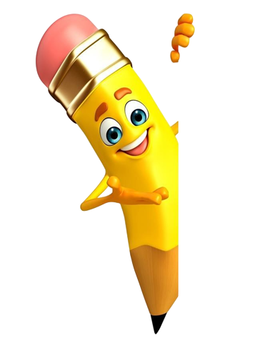
YOUR SOLUTION AND ITS VALUE PROPOSITION
Solution:
Our solution revolves around leveraging stable diffusion models integrated with generative AI to produce high-quality, diverse, and realistic images for a wide range of applications. add one more sentence. It offers a user-friendly interface and seamless integration with existing workflows, ensuring accessibility and ease of adoption for both novice and experienced users alike.
Value Proposition:
Enhanced Image Quality: By employing stable diffusion models, we can generate images with improved visual fidelity, capturing intricate details and nuances that may be challenging for traditional methods.
Increased Diversity: The integration of generative AI allows for the creation of diverse image outputs, spanning different styles, compositions, and content categories. This diversity enhances creativity and expands the range of possible applications.
Realistic Output: The combination of stable diffusion models and generative AI enables the generation of photorealistic images that closely resemble real-world scenes, making them suitable for various visual simulation and rendering tasks.
Scalability and Efficiency: Our solution offers scalability and efficiency in image generation, enabling the creation of large-scale, high-resolution images while optimizing computational resources and training time.
Customization and Control: Users have the flexibility to customize and control the image generation process, adjusting parameters and settings to achieve desired outcomes tailored to specific application requirements.

Slide 8

THE WOW IN YOUR SOLUTION
Seamless integration of stable diffusion models and generative AI for image generation
Consistent delivery of high-quality, diverse, and realistic images
Revolutionary approach setting a new standard in visual content creation
Versatility across a wide range of applications
Accessibility and ease of adoption with a user-friendly interface
Empowering both novice and experienced users to create compelling visual content
Redefining the boundaries of image generation with cutting-edge technology.
3/21/2024 Annual Review
‹#›

Slide 9
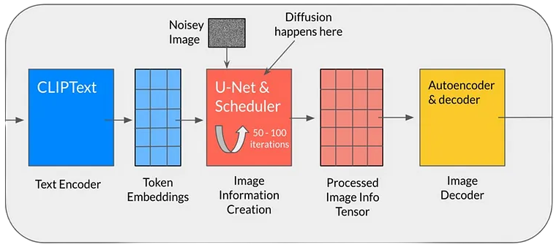
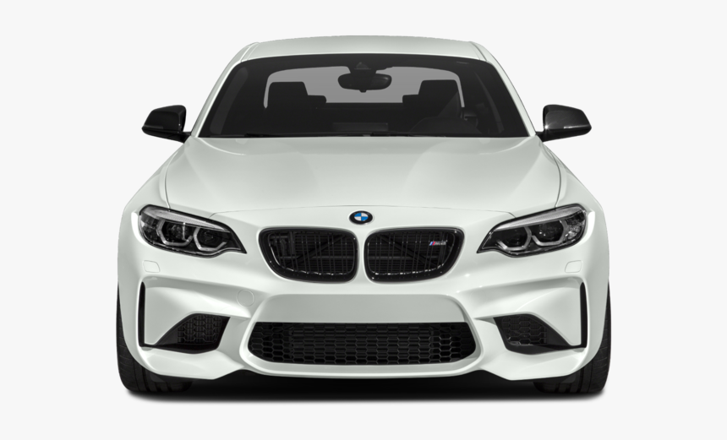
MODELLING
STABLE DIFFUSION
INPUT TEXT
GENERATED IMAGE
512 X 512
‹#›

Slide 10
RESULT
This project aims to advance image generation techniques by leveraging stable diffusion models and generative AI, providing insights for future research and practical applications.
Demo Link
‹#›

